Slide 1
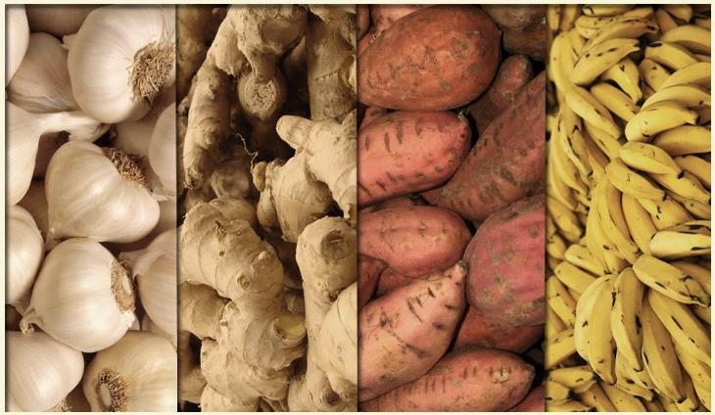

The Design of a Controlled Environment System for High Value Crops

Slide 2
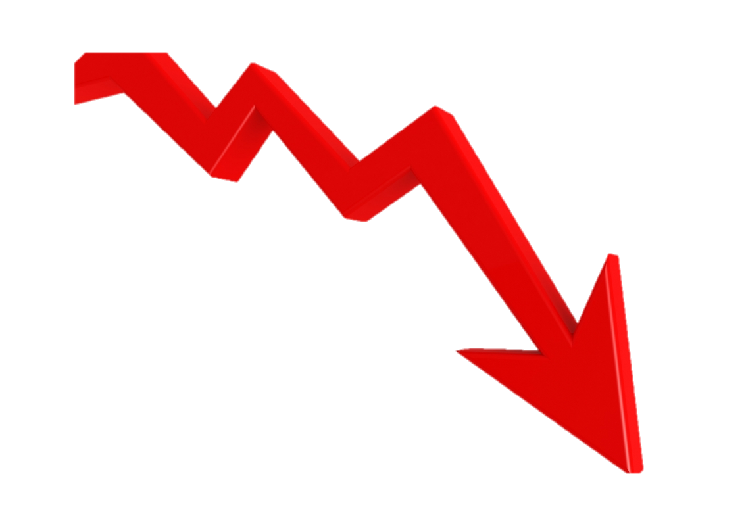
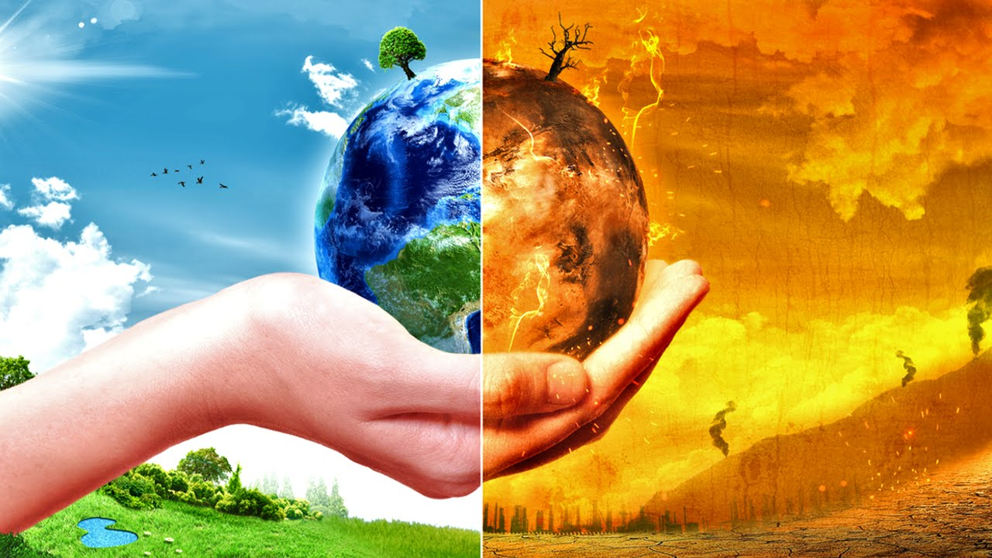
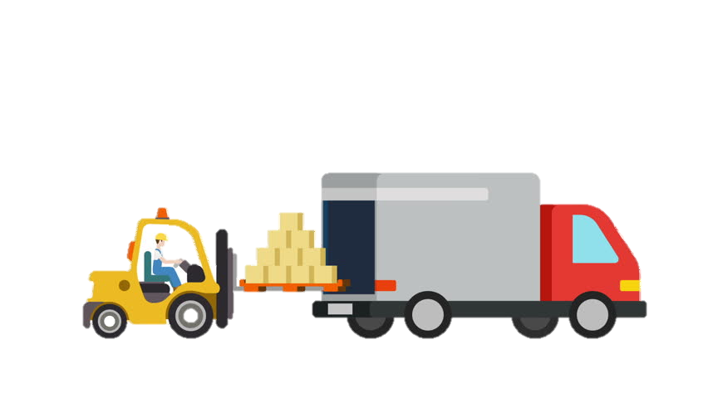

THE PROBLEM
ARABLE LAND
WATER
ECOSYSTEM
CLIMATE CHANGE
COST
=
QUALITY
TRANSPORTATION OF GOODS

Slide 3


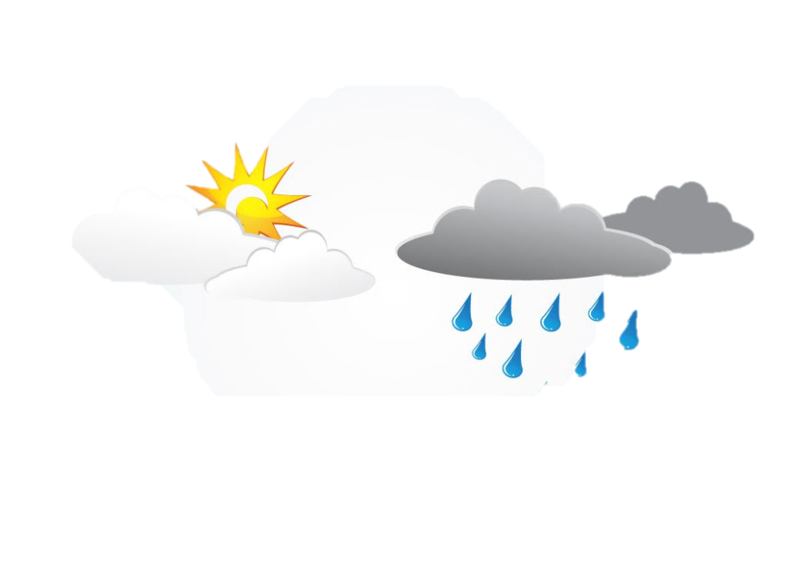


OLD SCENARIO
Farms @
PROVINCES
Unpredictable Weather Condition
+
=
PRODUCTION
PROFIT
Farm

Slide 4

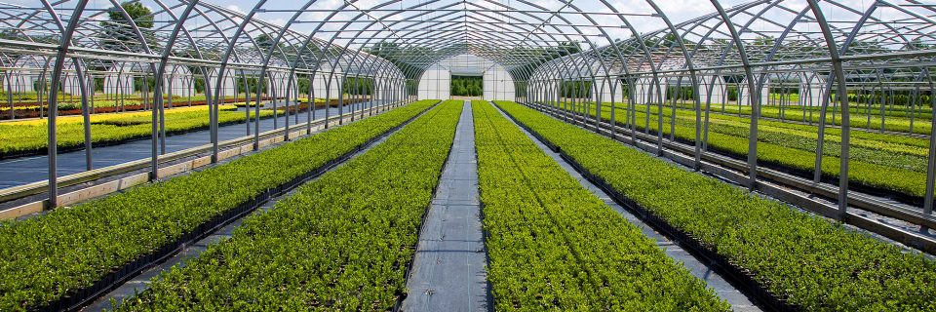


CURRENT SCENARIO
Farms @
PROVINCES
Greenhouse Farming
+
=
PRODUCTION
PROFIT
LONG
QUALITY
NOT controlled
LIMITED type of crops
PRICE

Slide 5


PROPOSED SCENARIO
Farms @
CITIES
Controlled Environment System
+
=
PRODUCTION
PROFIT
SHORT
QUALITY
Controlled variables
PRICE
Temperature Light
Humidity Nutrients
Carbon Dioxide pH

Slide 6
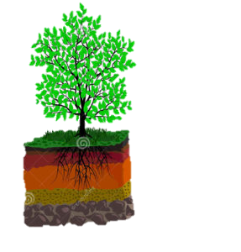
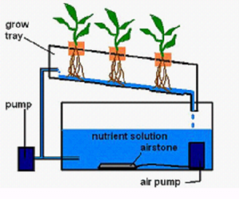
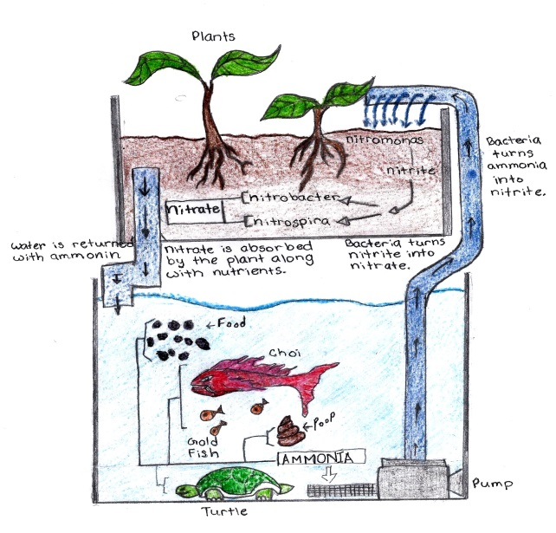
DESIGNS
CONTROLLED ENVIRONMENT SYSTEM
SOIL-BASED
HYDROPONICS
AQUAPONICS
Lack of
arable land
Water
Use Efficiency
Limited type
of high value crops

Slide 7
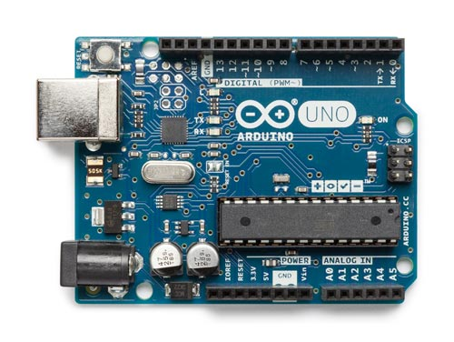
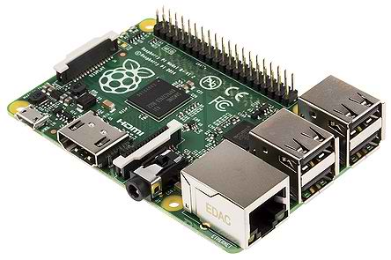
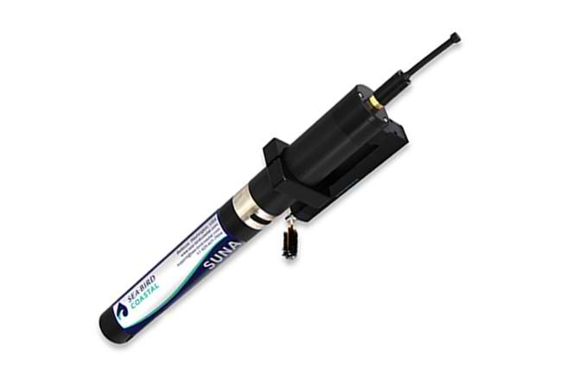
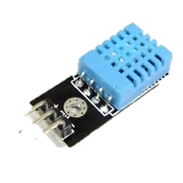
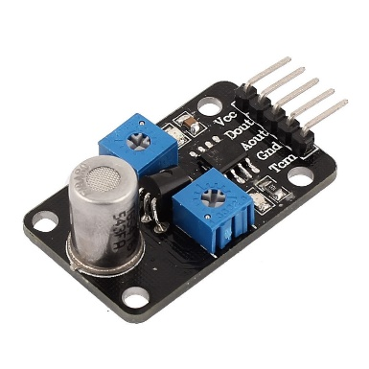
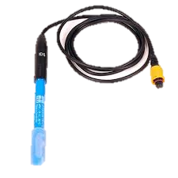
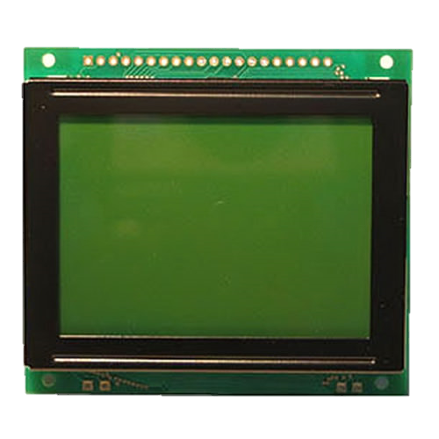
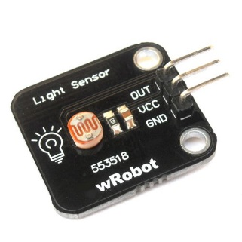
DESIGNS
CONTROLLED ENVIRONMENT SYSTEM
Arduino Uno
Raspberry pi
Temperature
& Humidity Sensor
Database
Nutrients Sensor
pH Level Sensor
CO2 Sensor
Light Sensor
LCD Display

Slide 8
THANK YOU!

